Slide 1
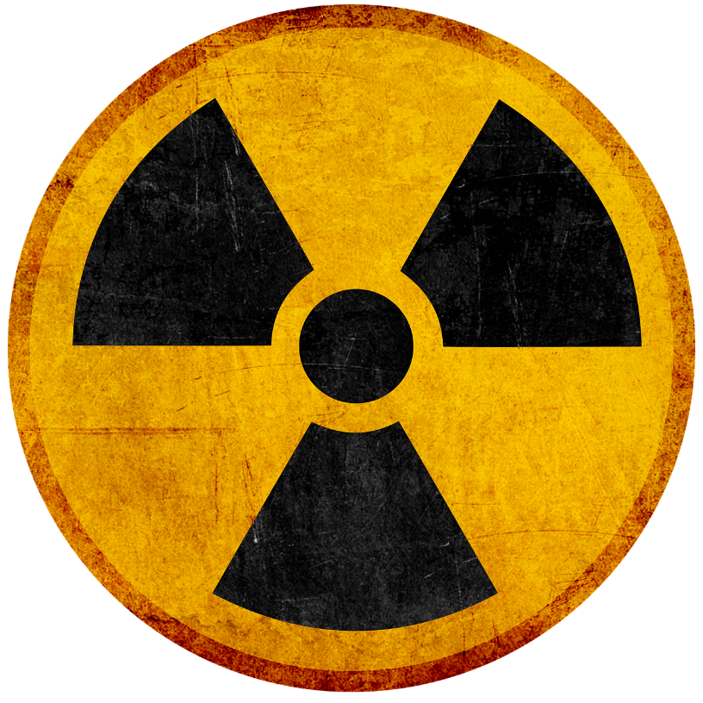
Understanding Radon
And its effect on your health

Slide 2
Today:
What is Radon
What impact does Radon have on Health
How to Fix it
Other Information

Slide 3
Radon is a Radioactive Gas
Radon is a naturally occurring gas
Radon’s radioactive properties mean that it spontaneously changes and releases energy
The energy released causes damage to the lung cell tissue – resulting in a risk of lung cancer
Radon is naturally occurring, but it can reach unnatural concentrations inside our buildings.

Slide 4
How do we know that Radon is a health concern?
The radioactive properties of radon and associated radon decay chain presents a risk to human health
Initial research in miners exposed to radon in uranium mines provided an indicator of risk and initial risk estimates.
Residential case control studies confirmed the risk at lower levels.
In 2006 a report was produced that initiated a change in Health Canada’s radon action level from 800 Bq/m³ to 200 Bq/m³.

Slide 5
+
Radon – 800 Bq/m³
1 in 20 non-smokers exposed to a
lifetime of high radon will die of
lung cancer.
1 in 3 smokers exposed to a lifetime of high radon will die of lung cancer.
Radon causes non-smokers to be at a risk of lung cancer.
Radon significantly increases smokers’ risk of lung cancer.

Slide 6
Where is Radon a concern?
Homes
Schools
Any building that has contact with the ground has a potential
Health Canada survey showed that 7% of Canadian homes were above guideline.

Slide 7
Testing for radon is easy
There are simple steps to follow
Testing should be done for 91 days or more during the heating season when levels are typically highest
These devices are easy to obtain
You can hire a professional to help test
Let’s help prevent cancer…
Test & Reduce Radon

Slide 8
Health Canada helped initiate a national certification program
C-NRPP has certified professionals in every province
Measurement professionals test for radon
Mitigation professionals reduce radon levels in buildings
C-NRPP = Canada’s National Radon Proficiency Program

Slide 9
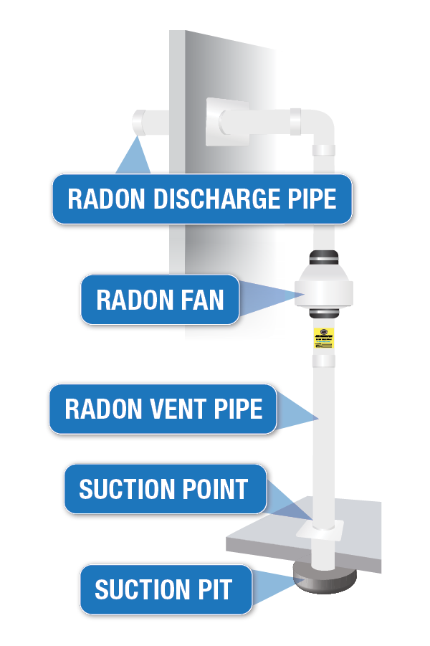
A radon mitigation system is the most effective way to reduce radon
It is proven to be effective and when installed properly it is efficient
Once installed, it protects all future occupants.
Simple to maintain
ALL HOMES CAN BE FIXED.

Slide 10
The National Building Code addresses radon
National code includes radon control measures:
Gravel under the slab
Well-sealed liner
Sealed sump pit
Radon rough-in for future installation
Our government is changing policies to address radon.

Slide 11
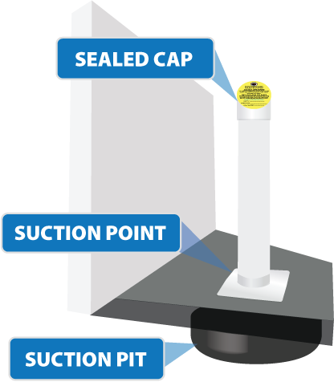
The radon “rough-in” is not a radon mitigation system; it’s simply the beginning of one.
Every home must be tested for radon, to determine if the rough-in needs to be completed with a pipe and fan.
The radon rough-in pipe is meant to be completed if required.

Slide 12
TARION HOME WARRANTY
Provides coverage in the first seven years for a radon mitigation system if levels are tested and found to be above Health Canada’s guideline of 200 Bq/m³.

Slide 13
Questions, comments?

Slide 14
Thank you!

